Slide 1

Knuth–Morris–Pratt and Aho–Corasick

Slide 2
Knuth – Morris – Pratt (KMP)

Slide 3
Definition
Knuth – Morris – Pratt (or KMP) algorithm is a algorithm that use to solve string matching problems, which is searching occurrences of “word” within the main “text – string”
KMP consists of two following steps:
- Preprocessing
- Searching/Matching

Slide 4
PROBLEM
Given a main string and a pattern string, check whether the pattern occurs in the main string?
For example:
  The main string: “ABXABABABAA”
  The word: “ABABAA"
  YES, the pattern is occurs in the main string (from character 6th).

Slide 5
MAIN IDEA OF KMP
The idea behind KMP is to extend a suffix ending at position i to a suffix ending at position i+1 while still matching the corresponding prefix, which improves efficiency by eliminating expensive string comparisons.

Slide 6
Naive algorithm
Main string:
A
B
X
A
B
A
B
A
B
A
A
Word:
A
B
A
B
A
A

Slide 7
Naive algorithm
Main string:
A
B
X
A
B
A
B
A
B
A
A
Word:
A
B
A
B
A
A

Slide 8
Naive algorithm
Main string:
A
B
X
A
B
A
B
A
B
A
A
Word:
A
B
A
B
A
A

Slide 9
Naive algorithm
Main string:
A
B
X
A
B
A
B
A
B
A
A
Word:
A
B
A
B
A
A

Slide 10
Naive algorithm
Main string:
A
B
X
A
B
A
B
A
B
A
A
Word:
A
B
A
B
A
A

Slide 11
Naive algorithm
Main string:
A
B
X
A
B
A
B
A
B
A
A
Word:
A
B
A
B
A
A

Slide 12
Naive algorithm
Main string:
A
B
X
A
B
A
B
A
B
A
A
Word:
A
B
A
B
A
A

Slide 13
Naive algorithm
Main string:
A
B
X
A
B
A
B
A
B
A
A
Word:
A
B
A
B
A
A

Slide 14
Naive algorithm
Main string:
A
B
X
A
B
A
B
A
B
A
A
Word:
A
B
A
B
A
A

Slide 15
Naive algorithm
Main string:
A
B
X
A
B
A
B
A
B
A
A
Word:
A
B
A
B
A
A

Slide 16
Naive algorithm
Main string:
A
B
X
A
B
A
B
A
B
A
A
Word:
A
B
A
B
A
A

Slide 17
Naive algorithm
Main string:
A
B
X
A
B
A
B
A
B
A
A
Word:
A
B
A
B
A
A

Slide 18
Naive algorithm
Main string:
A
B
X
A
B
A
B
A
B
A
A
Word:
A
B
A
B
A
A

Slide 19
Naive algorithm
Main string:
A
B
X
A
B
A
B
A
B
A
A
Word:
A
B
A
B
A
A

Slide 20
Naive algorithm
Main string:
A
B
X
A
B
A
B
A
B
A
A
Word:
A
B
A
B
A
A

Slide 21
Naive algorithm
Main string:
A
B
X
A
B
A
B
A
B
A
A
Word:
A
B
A
B
A
A

Slide 22
Naive algorithm
Main string:
A
B
X
A
B
A
B
A
B
A
A
Word:
A
B
A
B
A
A

Slide 23
Naive algorithm
Main string:
A
B
X
A
B
A
B
A
B
A
A
Word:
A
B
A
B
A
A

Slide 24
Naive algorithm
Main string:
A
B
X
A
B
A
B
A
B
A
A
Word:
A
B
A
B
A
A

Slide 25
Naive algorithm
Main string:
A
B
X
A
B
A
B
A
B
A
A
Word:
A
B
A
B
A
A

Slide 26
Naive algorithm
Main string:
A
B
X
A
B
A
B
A
B
A
A
Word:
A
B
A
B
A
A

Slide 27
Naive algorithm
Main string:
A
B
X
A
B
A
B
A
B
A
A
Word:
A
B
A
B
A
A

Slide 28
Naive algorithm
Main string:
A
B
X
A
B
A
B
A
B
A
A
Word:
A
B
A
B
A
A

Slide 29
Naive algorithm
Main string:
A
B
X
A
B
A
B
A
B
A
A
Word:
A
B
A
B
A
A

Slide 30
Naive algorithm
Main string:
A
B
X
A
B
A
B
A
B
A
A
Word:
A
B
A
B
A
A

Slide 31
Naive algorithm
Main string:
A
B
X
A
B
A
B
A
B
A
A
Word:
A
B
A
B
A
A

Slide 32

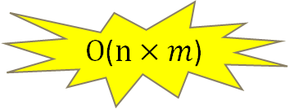
Naive algorithm
Main string:
A
B
X
A
B
A
B
A
B
A
A
Word:
$Ο$($n×m$)
A
B
A
B
A
A
Time Complexity?
$Θ$($1$)
Space Complexity?

Slide 33

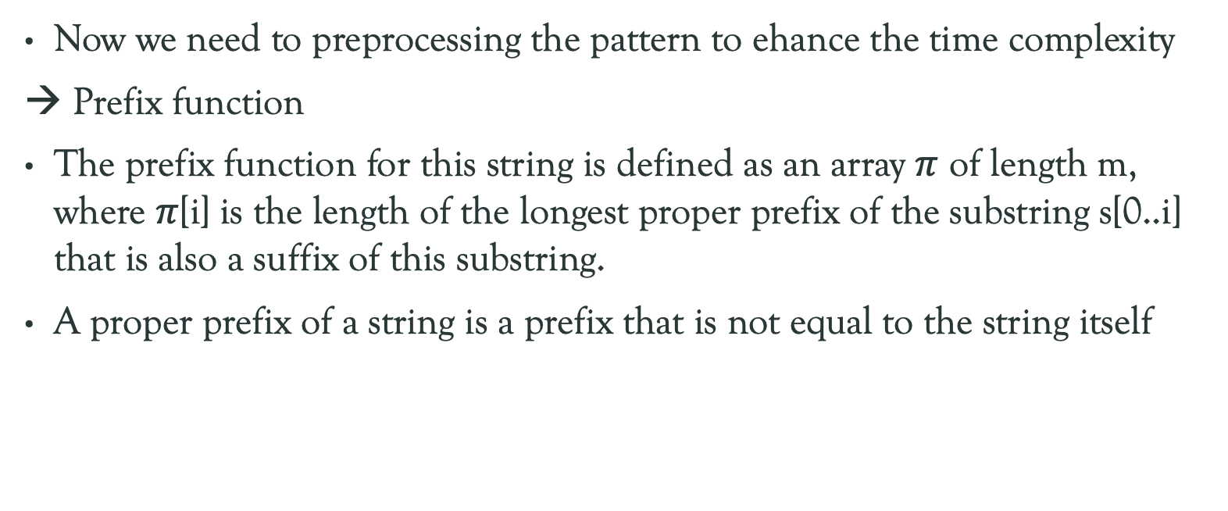
Preprocessing
Now we need to preprocessing the pattern to ehance the time complexity
→ Prefix function
The prefix function for this string is defined as an array $π$ of length m, where $π$[i] is the length of the longest proper prefix of the substring s[0..i] that is also a suffix of this substring.
A proper prefix of a string is a prefix that is not equal to the string itself

Slide 34


Preprocessing
J
I
0
0
1
2
3
1
A
B
A
B
A
A
$Θ$($m$)
Time Complexity?
$Θ$($m$)
Space Complexity?

Slide 35
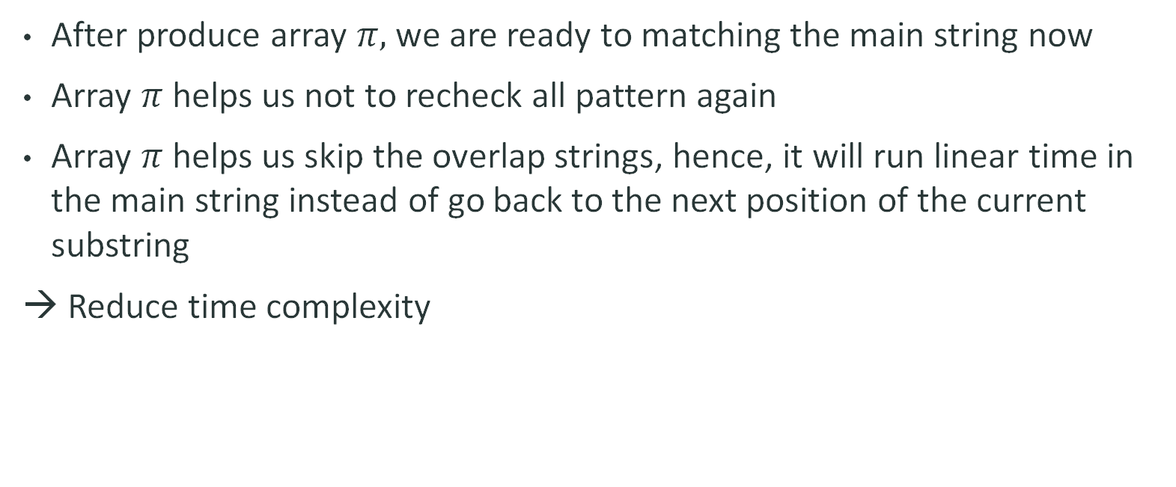
String matching
After produce array $π,$ we are ready to matching the main string now
Array $π$ helps us not to recheck all pattern again
Array $π$ helps us skip the overlap strings, hence, it will run linear time in the main string instead of go back to the next position of the current substring
→ Reduce time complexity

Slide 36

String matching
A
B
X
A
B
A
B
A
B
A
A
A
B
A
B
A
A
$Ο$($n+m$)
0
0
3
Time Complexity?
0
1
2
1
$Θ$($m$)
Space Complexity?

Slide 37
AHO-CORASICK

Slide 38
Definition
The Aho-Corasick algorithm is a dictionary-matching algorithm that can find all the occurrences of all sets of patterns within a given text in linear time.
Aho – Corasick consists of two following steps:
- Preprocessing
- Searching/Matching

Slide 39
PROBLEM
Give a text and a set of multiple pattern strings, check how many pattern strings occur in the text?
For example:
  The Text: “DIDIDUADI”
  The Pattern strings: “DI”, “DIDU”, “DIDI”, “DU”, “DUDUA”, “DUADI”
  There are 5 pattern occur in the text: “DI”, “DIDU”, “DUDUA”, “DUADI”, “DU”.

Slide 40
MAIN IDEA OF AHO-CORASICK
Based on KMP algorithm’s main idea, Aho-Corasick links the suffix ending at position i of the pattern to the prefix of another pattern string having the same as the suffix.
So that, Aho-Corasick constructs trie structure to contain multiple pattern strings and each node of trie has a link pointing to the prefix that is similar to the suffix of current substring. If there aren’t any prefix similar to the suffix, the link will point to the root of trie.
The searching or matching process uses the link to link to the prefix when the mismatching occurs, so that we don’t have to check the same substring many times.

Slide 41
ABOUT TRIE
It’s a tree data structure used for storage multi string. Every string having the same prefix has the same parents. Each node contains a character of a string
For example, this is a trie structure storages the pattern strings in the first example
D
I
U
D
D
A
I
U
U
D
A
I

Slide 42
preprocessing

Slide 43
Linking the node
D
D
I
U
I
U
D
D
A
D
D
A
I
U
U
D
I
U
U
D
A
I
A
I

Slide 44
STEp 1: create a trie and LINK ALL THE NODE TO THE ROOT
D
I
U
D
D
A
I
U
U
D
A
I

Slide 45
STEP 2:RELINKING THE NODE
D
At node i, we call node which the link of node i’s parent points at is x.
If x is the root, we do nothing.
If the child of node x is as same as node i,
the link of node i will point to node x’s child. Otherwise, we do nothing.
I
U
D
D
A
I
U
U
D
A
I

Slide 46
D
I
U
D
D
A
I
U
U
D
A
I

Slide 47
D
The parent of node ‘D’ is a root.
So we do nothing.
I
U
D
D
A
I
U
U
D
A
I

Slide 48
D
Move to Node ‘I’
I
U
D
D
A
I
U
U
D
A
I

Slide 49
D
The parent of node ‘I’ is node ‘D’ and the link of that node point to the root.
The root don’t have child as same node ‘I’ so we do nothing
I
U
D
D
A
I
U
U
D
A
I

Slide 50
D
The parent of node ‘I’ is node ‘D’ and the link of that points to the root.
The root don’t have child as same node ‘I’ so we do nothing
I
U
D
D
A
I
U
U
D
A
I

Slide 51
D
Move to node ‘D’
I
U
D
D
A
I
U
U
D
A
I

Slide 52
D
The parent of node ‘D’ is node ‘I’ and the link of that points to the root.
The root has node ‘D’ as its child node so the link of node ‘D’ will point to that child node.
I
U
D
D
A
I
U
U
D
A
I

Slide 53
D
The parent of node ‘D’ is node ‘I’ and the link of that points to the root.
The root has node ‘D’ as its child node so the link of node ‘D’ will point to that child node.
I
U
D
D
A
I
U
U
D
A
I

Slide 54
D
Move to node ‘I’
I
U
D
D
A
I
U
U
D
A
I

Slide 55
D
The parent of node ‘I’ is node ‘D’ and the link of that points to another node ‘D’.
That node ‘D’ has node ‘I’ as its child node so the link of node ‘I’ will point to that child node.
I
U
D
D
A
I
U
U
D
A
I

Slide 56
D
The parent of node ‘I’ is node ‘D’ and the link of that node points to another node ‘D’.
That node ‘D’ has node ‘I’ as its child node so the link of node ‘I’ will point to that child node.
I
U
D
D
A
I
U
U
D
A
I

Slide 57
D
Node ‘I’ doesn’t have any child node so we move back to node ‘D’ and move to another ‘D’ ’s child node
I
U
D
D
A
I
U
U
D
A
I

Slide 58
D
Node ‘I’ doesn’t have any child node so we move back to node ‘D’ and move to another ‘D’ ’s child node
I
U
D
D
A
I
U
U
D
A
I

Slide 59
D
The parent of node ‘U’ is node ‘D’ and the link of that node points to another node ‘D’.
That node ‘D’ has node ‘U’ as its child node so the link of node ‘U’ will point to that child node.
I
U
D
D
A
I
U
U
D
A
I

Slide 60
D
The parent of node ‘U’ is node ‘D’ and the link of that node point to another node ‘D’.
That node ‘D’ has node ‘U’ as its child node so the link of node ‘U’ will point to that node.
I
U
D
D
A
I
U
U
D
A
I

Slide 61
D
I
U
Continue with other nodes, we will have a trie tree with links like this picture
D
D
A
I
U
U
D
A
I

Slide 62
Searching/ matching process

Slide 63
SEARCHING/ MATCHING PROCESS
STEP 1: At the ith position of the text, if the current node has a child node as same as that character, we travel through that child node. Otherwise, we trace back to other prefix by using the link to check other child node until there is a child node as same at the character.
STEP 2: After travel to that node, we use the link to trace back to all the prefix to assure all the pattern have been checked.

Slide 64
The text: “DIDUDUADI”
D
I
D
U
D
U
A
D
I
D
I
U
The pattern strings occur in the text:
D
D
A
DI
DIDU
I
U
U
D
DU
A
I
DUDUA
DUADI

